Slide 1
HTML5 Storage

Slide 2
Out line
1
2
3

Slide 3
Out line
Head up
Local Storage
Session Storage
Indexed DB
References

Slide 4
Indexed DB
What is it?
A way of store
significant amounts
of
structured data
in web storage

Slide 5
Usage
Store Offline data
Single page app
data synchronization
Fat-Client website

Slide 6
Concept
Advantage points

Slide 7
Pros and Cons
Advantage points
Limitation
Compare to other storage

Slide 8
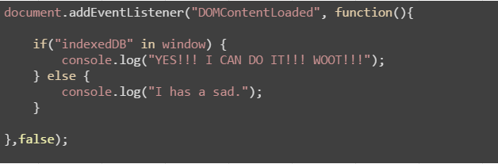
TITLE 1
Does your browser fit it?

Slide 9
Coding
OpenDB
Insert
Update
Delete

Slide 10
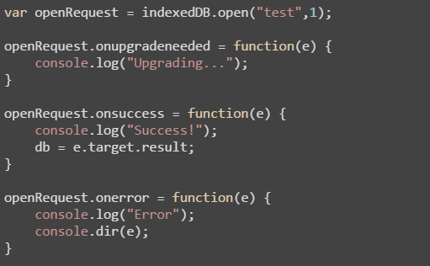
Open a DB
DB name
Schema version
onupgradeneeded

Slide 11
Data
One of the coolest aspects of IndexedDB
lets you store an object as is (JavaScript object)
Transactions
readonly | readwrite
Adding data = readwrite operation

Slide 12
TITLE 1
Does your browser fit it?

Slide 13
TITLE 1
Does your browser fit it?

Slide 14
Good library
Jquery IndexedDB Plugin
http://nparashuram.com/jquery-indexeddb/

Slide 15
References
Working With IndexedDB http://code.tutsplus.com/tutorials/working-with-indexeddb--net-34673

Slide 16
TITLE 1
Does your browser fit it?

Slide 17
Old way storing data
Uploading to server
Saving data in cookie
Notes:
When web developers think of storing anything about the user, they immediately think of uploading to the server or saving data in cookie. HTML5 changes that, as there are now several technologies allowing the app to save data on the client device. It might also be sync'd back to the server, or it might only ever stay on the client: that's down to you, the developer.

Slide 18
Behind the cookie
Store identifying information
Extremely limited capacity, 4k limit per cookie
Sent with every HTTP request => higher bandwidth usage & slower request times
Old-school but cross-browser
Notes:
Cookies have been around since the early days of the web. They were originally intended to associate a little data with the user, though these days, most applications only store identifying information, and store the rest of the user's data on the server. Still, the fact that cookies can store some data does put them in the category of offline storage. However, the data capacity is extremely limited, as low as 20 cookies limited to 4KB each according to specification. Just as important, cookies slow down network activity because they are transferred to and from the server inside HTTP headers.

Slide 19
What we want?
Work on the client
Has a lot of storage space
Persists beyond a page refresh
Isn’t transmitted to the server

Slide 20
HTML5 Web Storage
In key/value pairs form
Has API to retrieve/write data
Only supports String

Slide 21
Local Storage
VS
Session Storages
Stores data with no expiration
Data available even when the browser/tab is closed or reopened.
Stores data for one session
Data is cleared as soon as closing the browser, mostly for security purposes
Web storage data will not be available between different browsers

Slide 22
The good things ☺
App can work offline, be possible to sync
Large capacity 5 - 10MB/domain
Read in client (JS), easier programming, no server infrastructure required, no database queries needed
Support caching, boost performance, quickly render
Notes:
First, you can make your app work when the user is offline, possibly sync'ing data back once the network is connected again.
You can show a large amount of data as soon as the user clicks on to your site, instead of waiting for it to download again.
Offline technologies support caching and detailed control over caching process. Therefore, web apps can boot quickly and show data instantly.

Slide 23
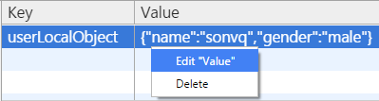
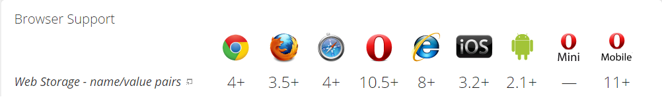
The bad things ☹
Security: more vulnerable => use for non-critical data only
Usability: can't access from multiple clients/devices
Browser: not fully supported
Notes:
Of course, the data is more vulnerable and the user can't access it from multiple clients, so you should only use it for non-critical data, e.g. a list of recent searches, in particular cached versions of data that's also "in the cloud".

Slide 24
When?
Making offline apps (Airplane activity)
Bandwidth, throughput, latency are important (Video apps)
Notes:
- Making offline apps just for airplane activity, which is the one place you're likely to be offline for a long period of time. But there are still situations where it's worthwhile, and also situations where offline technologies are useful for protecting against server or network outages.
- Although bandwidth is much faster these days, there are still noticeable limitations for certain applications, in terms of both throughput and latency. If you were designing a high-density video editor, you'll probably find the video is too big to fit into memory at once, meaning you have to swap content in and out of your app. It would be painfully slow to store the whole thing on a server (unless you and all your users are lucky enough to be on a super-fast network). Much better to store the entire video offline and push changes to the server as and when they happen.

Slide 25
App cache
VS
Offline Storages
Save app's core logic & UI
HTML, JS, CSS, IMGs, etc
Load immediately next time
Save user-specific data
Restore the state of app
Save local every10s, upload server every 5m => bandwidth saving
Notes:
Imagine a game. Application caching would retain the initial HTML document, the JavaScript, the CSS, frequently used icons and images for game characters and scenes, and sound samples. Consequently, the next time the user visited the site, it would load immediately.
In our game example, visiting the site the second time round would load the site instantly, but what if we wanted to let the user continue playing the game from a previous position, i.e. we'd like to restore the state of the game. The kind of data required is not held in the application cache, because it's user-specific, so this is a job for offline storage. Whenever the user hits save, we upload to the cloud but we also store game data on disk at the same time, i.e. store it offline (for example, we might save the player's health level and the states of all objects and characters inside the game universe). We might even keep a loop running to continuously store the game data offline. That way, the latest changes are still there if the user lost connectivity and had to shut down the browser before they could get online again. It also takes less bandwidth than continuously uploading state to the server, e.g. we might save data locally every 10 seconds, while uploading it only every 5 minutes as a bandwidth-saving measure.

Slide 26
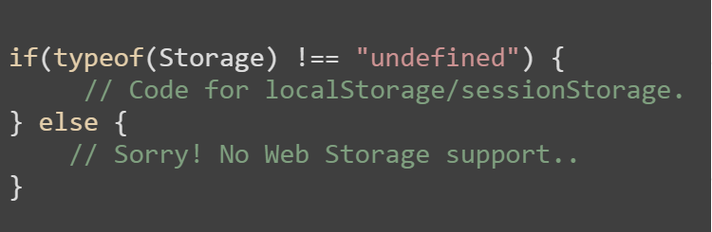
How to use
Check browser support

Slide 27




How to use
SET
GET
DELETE
CLEAR ALL

Slide 28
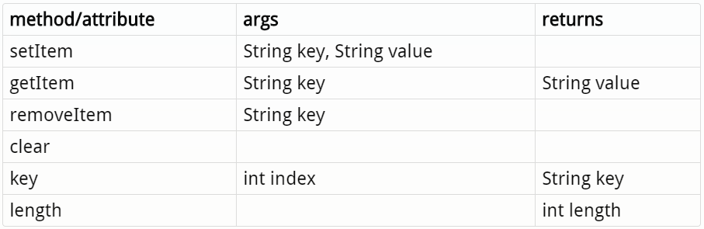
How to use

Slide 29
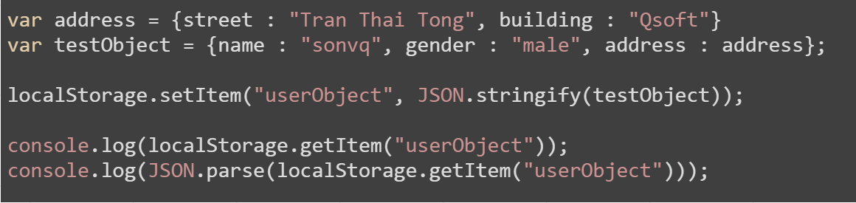
How to use
localStorage only supports String
Deal with obj & array: use JSON.stringify() & JSON.parse()
Notes:
var address = {street : "Tran Thai Tong", building : "Qsoft"}
var testObject = {name : "sonvq", gender : "male", address : address};
localStorage.setItem("userObject", JSON.stringify(testObject));
console.log(localStorage.getItem("userObject"));
console.log(JSON.parse(localStorage.getItem("userObject")));

Slide 30
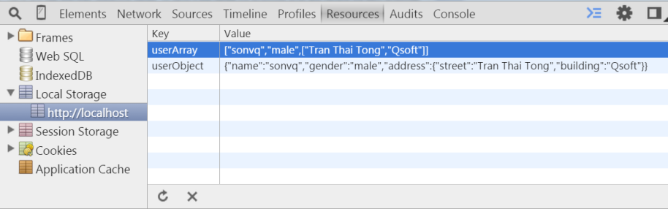
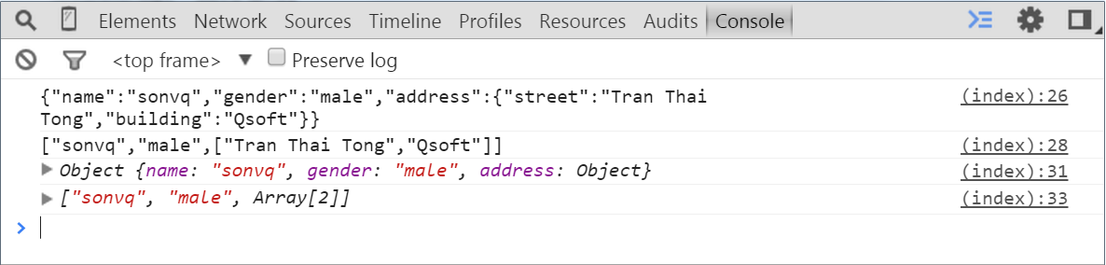

Slide 31

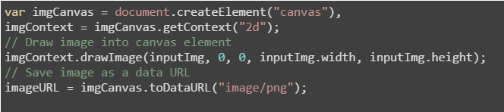
How to use
Deal with image & file: use dataURL => base64
Notes:
var reader = new FileReader();
// Read in the image file as a data URL.
reader.readAsDataURL(f);
var imgCanvas = document.createElement("canvas"),
imgContext = imgCanvas.getContext("2d");
// Save image as a data URL
storageFiles.elephant = imgCanvas.toDataURL("image/png");

Slide 32
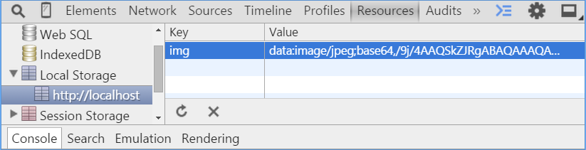
How to use
Notes:
var reader = new FileReader();
// Read in the image file as a data URL.
reader.readAsDataURL(f);
var imgCanvas = document.createElement("canvas"),
imgContext = imgCanvas.getContext("2d");
// Save image as a data URL
storageFiles.elephant = imgCanvas.toDataURL("image/png");

Slide 33
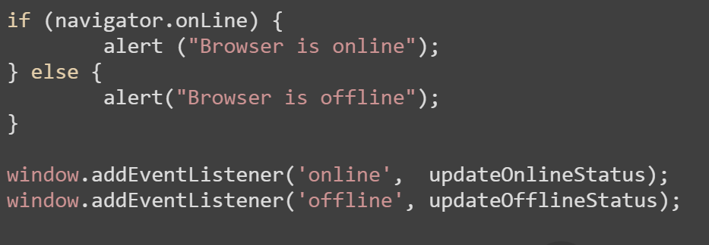
How to use
Check browser is online/offline
Notes:
if (navigator.onLine) {
alert ("Browser is online");
} else {
alert("Browser is offline");
}
window.addEventListener('online', updateOnlineStatus);
window.addEventListener('offline', updateOfflineStatus);

Slide 34
How to use
Check browser is online/offline
Offline.js Heyoffline.js
Offline.check() onOnline()
Offline.state onOffline()
Offline.on (event, handler, context)
Offline.off (event, handler)
http://github.hubspot.com/offline/docs/welcome/ http://krawczyk.io/heyoffline.js

Slide 35
Demo
save-storage.html
save-image.html
online-offline.html
online-offline-status.html

Slide 36
THANK YOU FOR YOUR ATTENTION!

